Slide 1
Name : Jainam Rajput

Slide 2


Slide 3
In corporate culture many things will be important , that we must follow in a corporate office.
So , lets understand that things.

Slide 4

First impression

Slide 5
When we enter in a corporate life the first important thing is our first impression. For make our first impression good we must wear a formal clothes. Always wear clean and iron clothes. Always use perfume that attract people . We must follow that thing because it impact on our first impression.

Slide 6
After enter in a corporate life there are some of rules that we must follow in a corporate office. Let’s understand that rules.

Slide 7
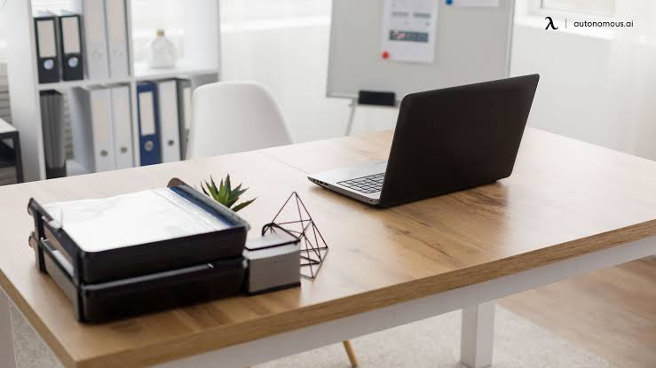
Keep your desk always clean

Slide 8
In the office we always keep clean our desk. We do not put things like pen , dairy , some other stationary item on the desk. We do not eat food on our desk . Use always dustbin for un-necessary things . Always sitting on a chair properly.

Slide 9
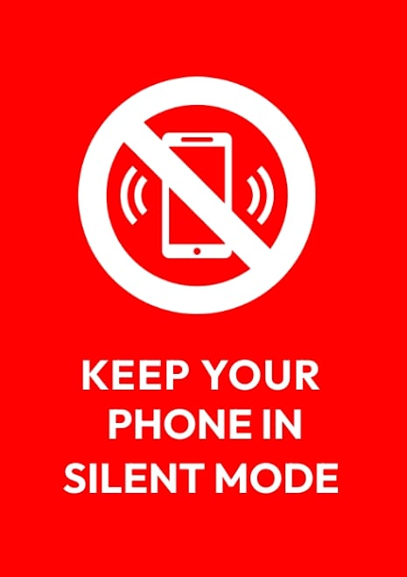
Always keep phone in silent mode

Slide 10
When we are in the office, we always keep our mobile phone in the silent mode , because if we don’t keep that in the silent mode and the phone is ringing that disturb other people in the office , so always keep mobile in the silent mode. If there is a not urgent call then we avoid to take call.

Slide 11

Team work

Slide 12
In the corporate office multiple project will working at the same time. Many people work in the same projects , so we work in a team. When we work in the team, we always give respect to other team members. Always respect to every member opinion.

Slide 13

Meeting

Slide 14
In the corporate office there are organize meeting at every weekend or month-end. In these meeting we discuss that what can we do in a last week or a month. Also ,the host of the meeting will discuss that what we do in a next week or month so we attend the meeting and listening all the instruction very carefully. Always keep a note-pen because if some most important point are discussed then we can note it.

Slide 15
So, all these things always follow in a corporate life.
Thank you

